Slide 1
Task – 1 Inorbit Mall Visit - Problems

Slide 2
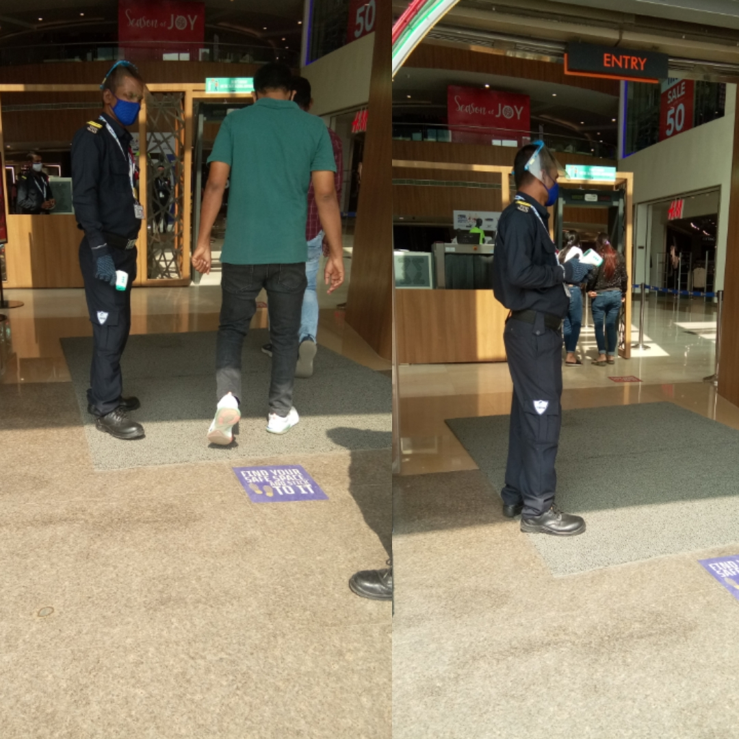
Checking The Visitors/Customers Temperature
Here, In The Right Side Picture, There is a Security Person Who is Checking the all visitors Temperature by using a Small Temperature Checking Device.
If we observe Carefully, The Security Person is weared Face Shield, Mask and Hand Gloves but the Visitors are not weared face shield and hand gloves, Here we can conclude that The Security person is coming contact with many people in a day, so he has more threat of covid-19 than the visitors of the mall.
This is the Problem at Entrance of the mall, Entrance of the shops inside mall, and as well as at the entrance of the shops outside the mall, Every where the situation is comman.

Slide 3
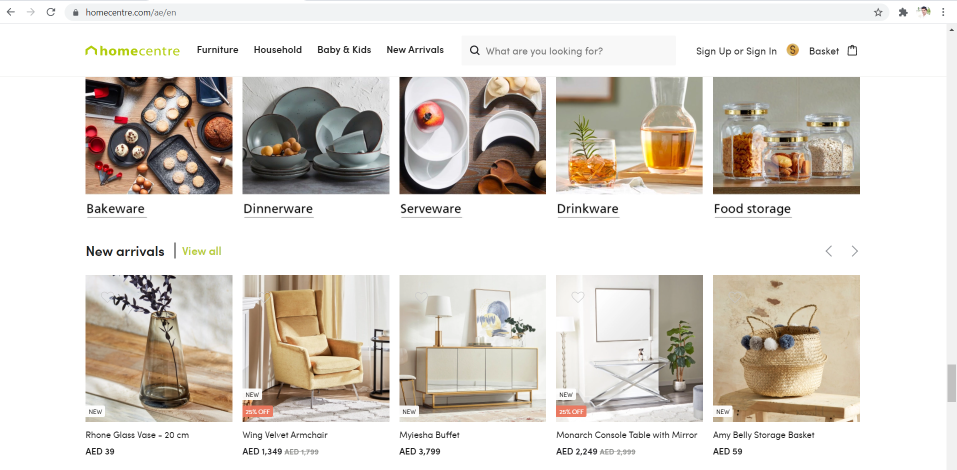
HOME CENTRE
For Every Business Having an Website/Application is an added advantage and Benefitable for their Business.
In “inorbit mall”, I went to a shop which name is “Home Centre”, There I have seen a display showing their Application(Products of their Store) and they said “You can download our application From playstore in your Mobile”.
In that homecentre store, there are many products, which we can’t see all products physically, in a specified time, so in that situation this application is an added advantage for their business, and also If we ask them about a particular product availability, then it is easy for them to find and give the update if they have an application.
I Found That, Many Medium size & large size of stores/businesses In The Mall doesn’t have their own application.

Slide 4
HOME CENTRE Cont…
Q) If most of the Businesses (Or) Stores Have an Application,Then What is the Difference B/w Online Businesses (i.e, Amazon,Flipcart,etc..,) and Others ???

Slide 5
HOME CENTRE Cont…
Ans) Incase Due to Covid-19 Situation,if the Lockdown was imposed, Then People can’t visit the Malls For Shopping, If there is an exemption for Cargo and Delivering The Products, in that time, we do shopping from malls also from their applications.(Business Application came into Picture in that situation)
Incase, if we have less time, then we can check the products which we want from the store which is in the Mall, when the time of while we are going to the mall or while we are having some food in the food court of that Mall.
Website link for Homecentre Store https://www.homecentre.com/ae/en

Slide 6
While Entering Into The Mall, Visitors don't know how many floors are In Functioning & how many are in construction (if it is newly constructing/constructed)and there in the mall in Which floor, what are the shops available. So Its Better To display the names of shops digitally floor wise In The Ground Floor Itself.
I went to the Furniture Shop In The Mall, There I Found This Situation/Problem, If People Want to buy furniture to some one who are in other location, if they want to send the pics and other details of the product to get confirmation from that person, it is difficult when we don't have a smart phone to send the pics of the product. (Here also Having a website/Application is an added advantage for their Business)
In the mall, there is a food court, all shops are build in a row without space, so customers are standing for a long time at the shops, to place orders, there is a huge human traffic, and when the shop keepers are calling the customers, sometimes it was not reaching to the customers then Its becoming a Problem. If we built a separate application for food court of a particular mall then at least few customers are habituated to use that application to place order at the food court of that particular mall. So that while entering into the mall, management is responsible to install that mall application in the customers mobile then they can find the details of the shops floor wise easily and they can search the products or food items easily without going there. Finally every mall needs their own web /mobile application.

Slide 7
At The Shops, They are Displaying the Discounts-Percentage(%).if customer don't know how to calculate the discount for the product, Then It’s also a minor problem. its better to develop a small application, to calculate all type of discounts,Percentages/Interest Rates.
if we came to the mall, mall having many floors , movie theater at the top floor, so if the visitor at the first floor he don't know what movies are playing in theater which is in the top floor, so in Ground/First floor of the mall Itself displaying of movies available in the theaters is good and also it is better to keep Movie Ticket Booking Counter in the ground/first floor itself.

Slide 8
I observed in some restaurants food menu was not displaying in screen....if restaurant shows menu digitally the customer will know the speciality of restaurant and their food items and they choose what they want.
If customer newly entered in shopping mall to buy clothes and cosmetics..i observed there is little bit confusion in them.customers are searching for it .I think we have to display the information of all categories of items.. it makes easy for the customers to buy items.its easy to understand the location of shops.
The most common problem included an inadequate selection of restaurants and too many stores carrying the same products and difficulty in finding a parking spots.we have to work on it to solve.

